Slide 1

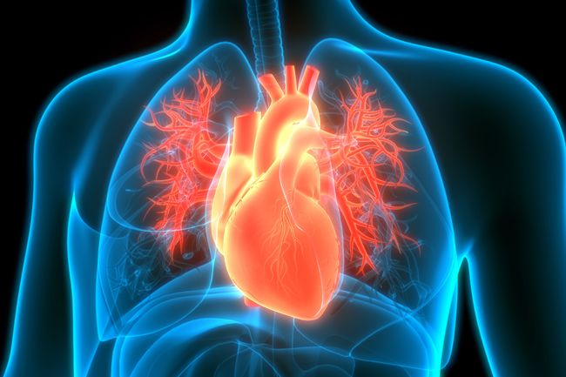
SC1015 Mini-Project
Heart Failure Prediction Dataset
Group 2:
TEO JIA YUN
LOW CHIN POH
TEO WEN JIE

Slide 2

Heart disease is the leading cause of death in the United States
With more research being placed on this issue, symptoms such as chest discomfort and shortness of breath are found to be prevalent with heart disease.

Slide 3
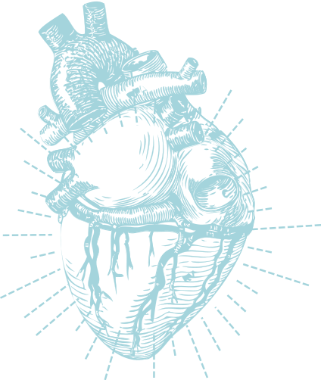

Can we predict if a person have heart failure?
If so, can we predict using one factor?

Slide 4
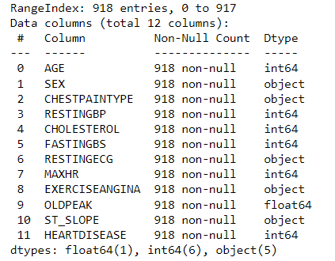
Heart Disease Data Set
No of entries - 918
Variables - 12
Numerical: 7
Categorical: 5

Slide 5
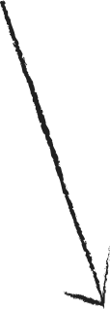

Visualization
Numerical
Categorical
Boxplot
Histogram plot
Heatmap
Cat-plot

Slide 6
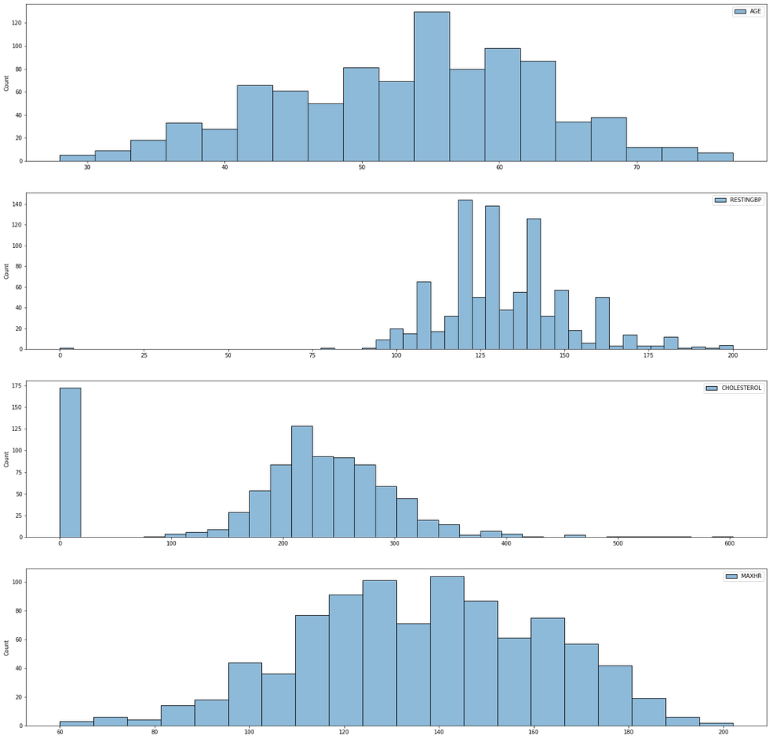
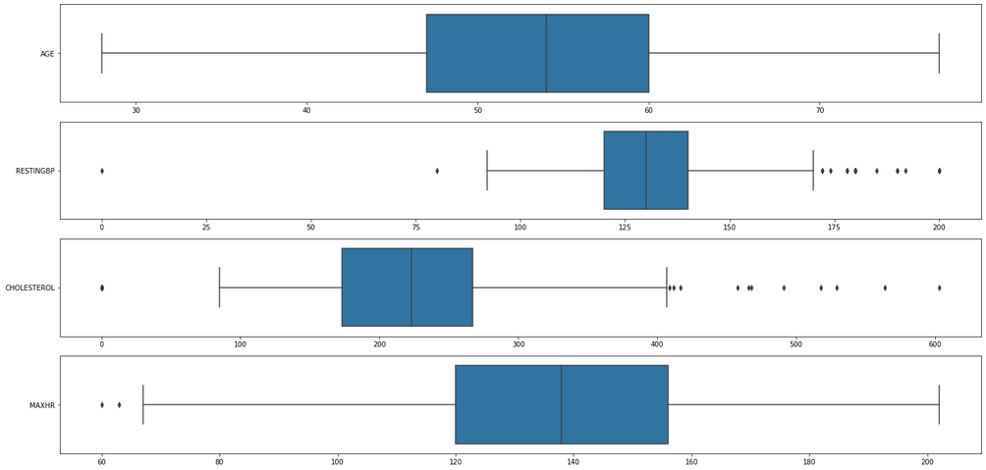
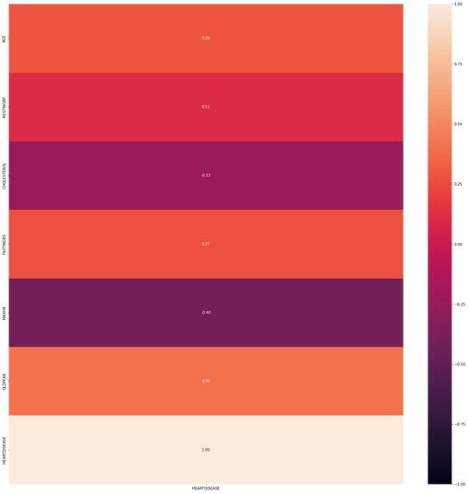
Histogram plot
Boxplot
Heatmap

Slide 7
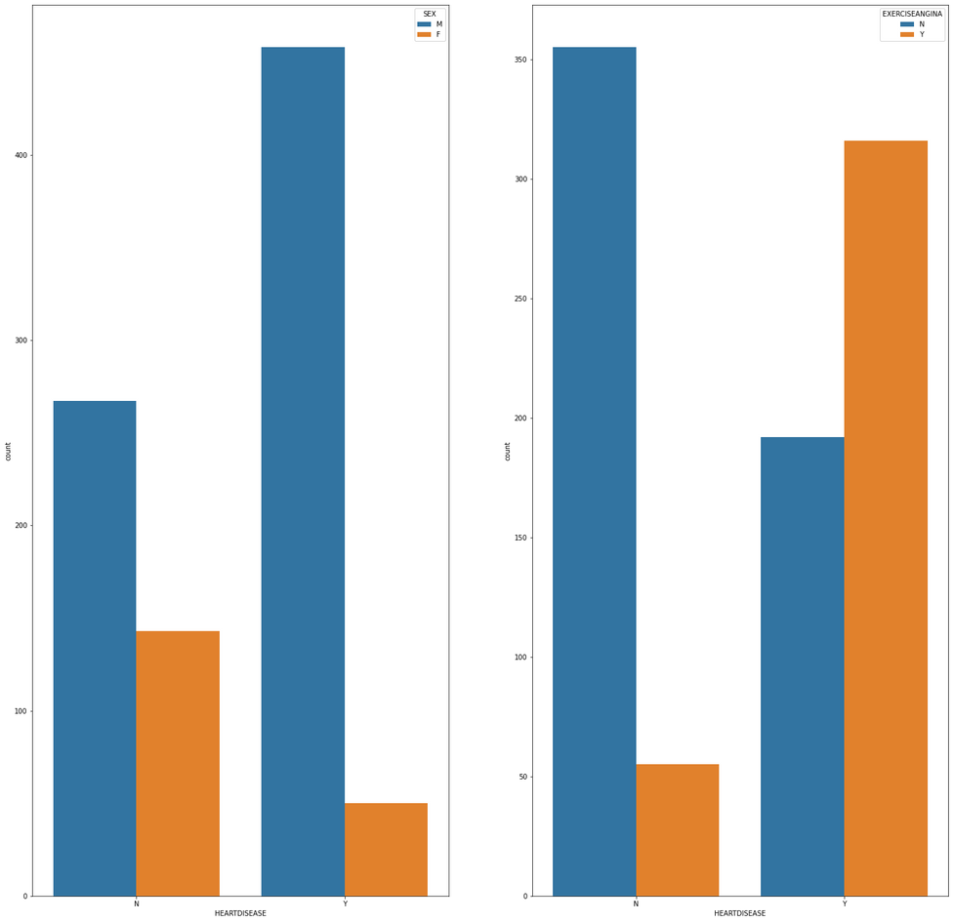
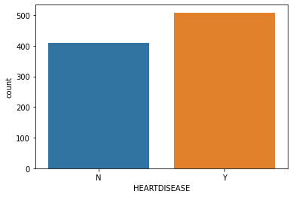
Cat-plot
univariate
bi-variate

Slide 8


Model fitting
Predictor features:
Age
Cholesterol
Max Heart Rate
Resting Blood pressure
Response Variable:
Heart Disease

Slide 9
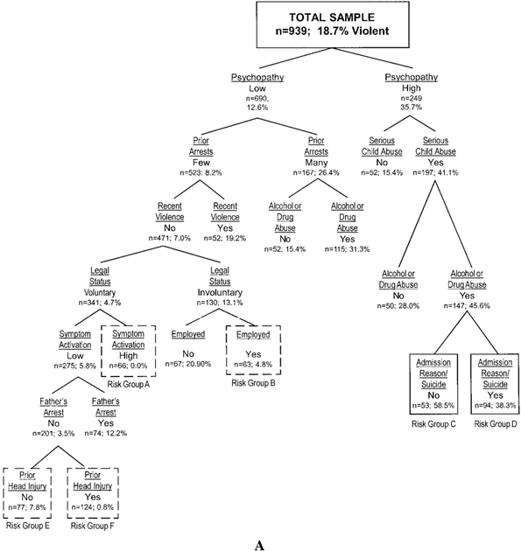
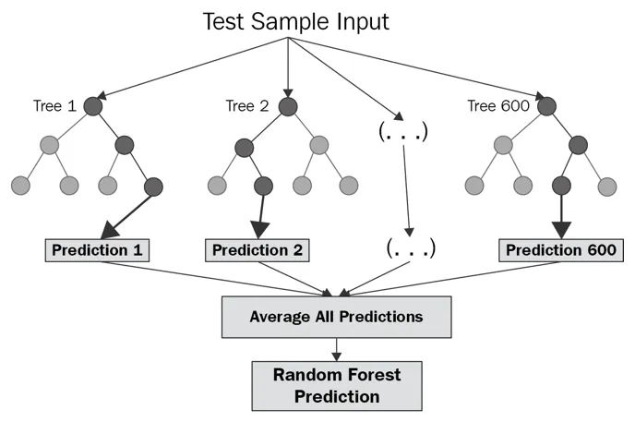

Types of model
1. CLASSIFICATION TREE
2. RANDOM FOREST
3. ARTIFICIAL NEURAL NETWORK

Slide 10
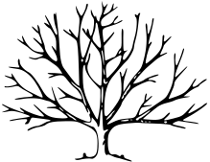
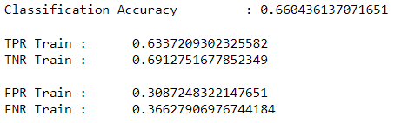
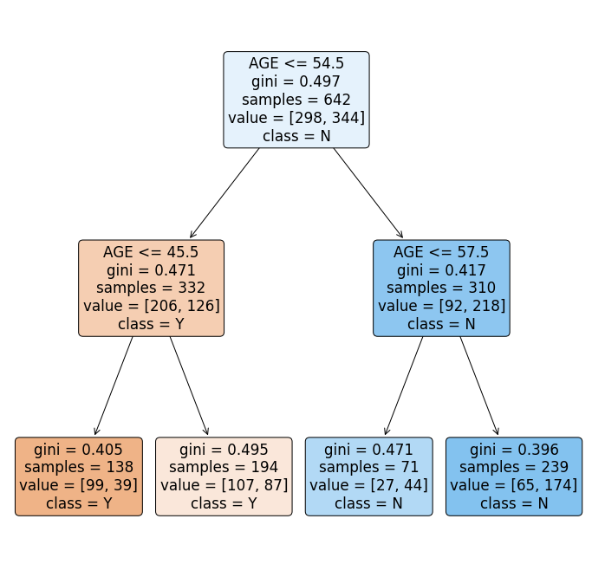
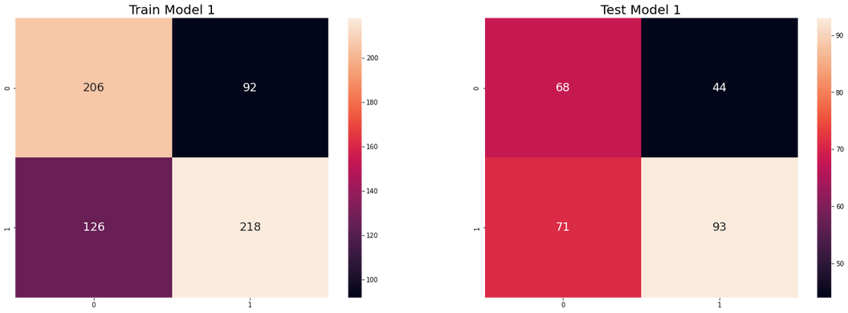
Model 1: Univariate Decision Tree Classifier

Slide 11
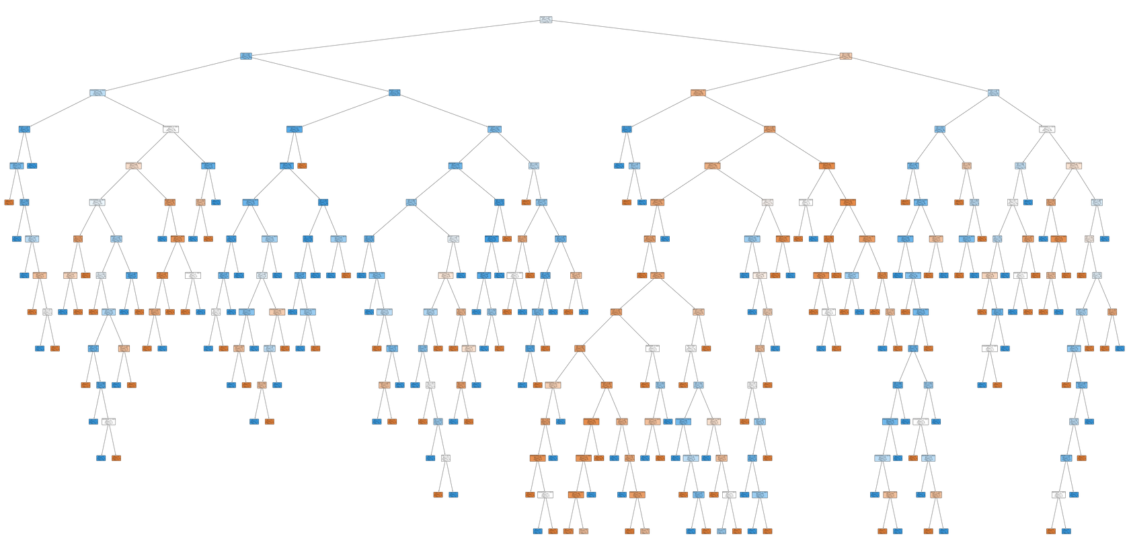
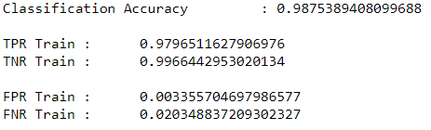
Model 2: Multivariate Decision Tree Classifier
4 Predictor Features
14 level of depth

Slide 12

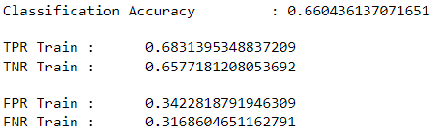
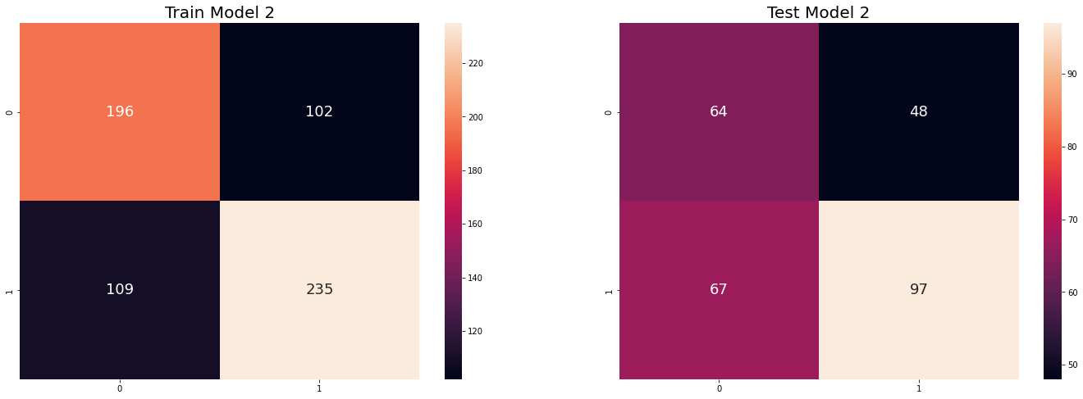
Model 3: Univariate Random Forest

Slide 13
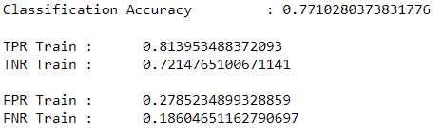
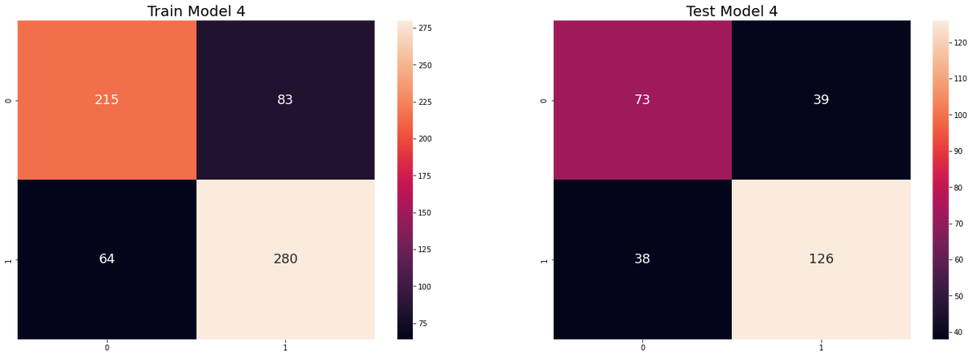
Model 4: Multivariate Random Forest

Slide 14
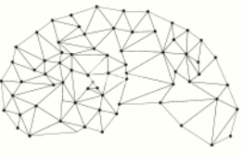
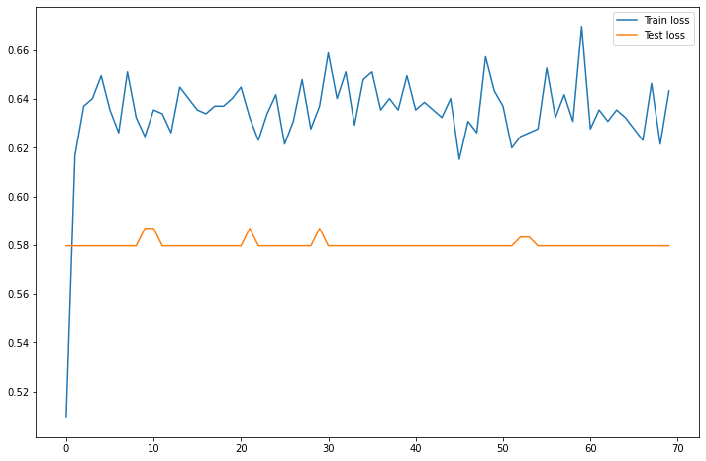
Model 5: Univariate Artificial Neural Network

Slide 15
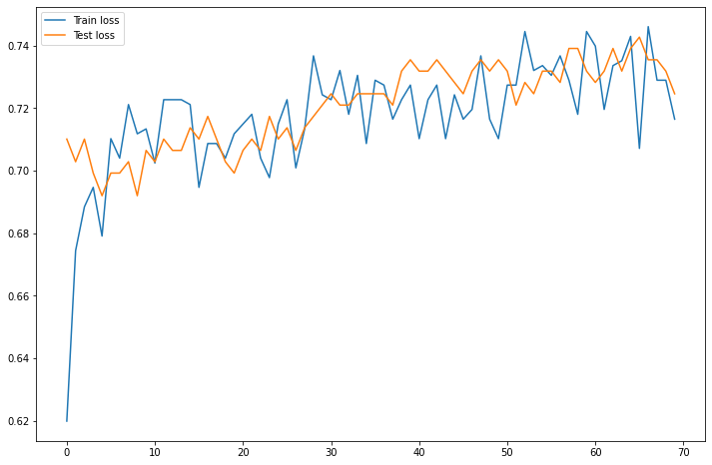
Model 6: Multivaraite Artificial Neural Network

Slide 16


What can we learn from the models?

Slide 17
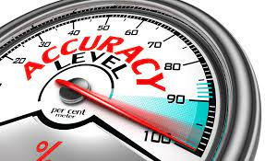

Univariate VS Multivariate
Univariate predictions
Often unsatisfactory and not feasible in the real-world application
Low classification accuracy
Multivariate
A better interpretation of the dataset
Suits the real work application and has higher classification accuracy.
Difficult data fitting process
Longer computation time.

Slide 18
CONCLUSION
Age
Age increases, the higher probability of getting the heart diseases
Cholesterol
An increase in cholesterol could get our heart artery block
Solution: Be conscious on diet,
Regular health check up
Max Heart rate
Increase active lifestyle
Blood Pressure
Active lifestyle and good diet habits

